Slide 1

Bridging the Gap between Industry and Academia
Research Based Training

Slide 2

INDUSTRY OUTLOOK – Higher Education
$319.167B | $70.62B | $247M | 25% | 100%
Entire World Higher Education | World level Online Market | Current India Online Market | Directly Employable across Globe from University | Job Role changes due to Technology Advancement and Pandemic
SUCCESS

Slide 3
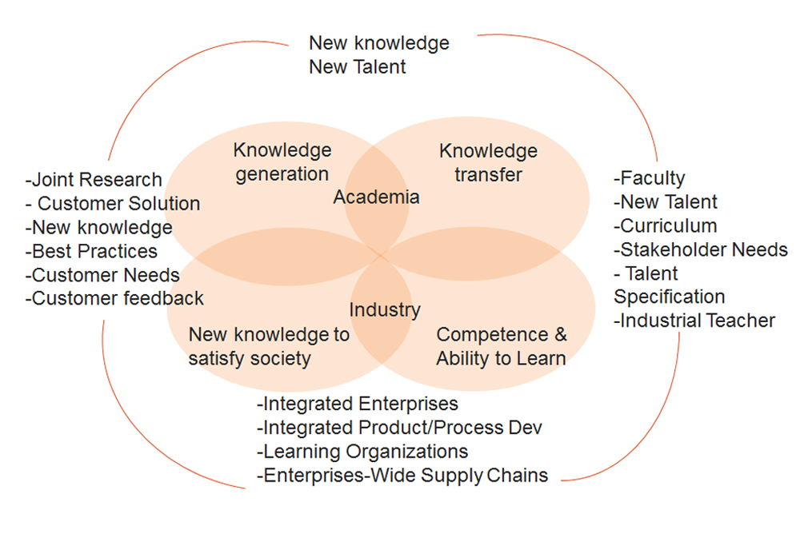

Our Vision
Our vision is to create an ecosystem to equip, empower and encourage the Human Talent for companies to contribute towards their growth through finding right talent and developing specific, customized and relevant research based training & mentoring programs using Technology+.

Slide 4




Our core values
Embracing Challenges
Ethics and Dignity
Diversity
Maintaining Quality

Slide 5
Our Goals
Enhancing the skill set of people is the main goal.
  To make them employable (Urban and Rural)
  Upskilling for already employed people
  Publishing of Technical articles and Papers
To develop Research based products for SME and MSME industries.
Collaboration with Universities / Colleges to serve as research wing by giving back to the society in terms of Technology
Research leading to IP and Patent Development

Slide 6
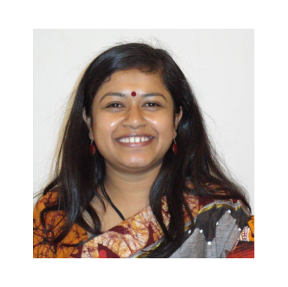
Meet The Directors
Ekata Mehul
Principle Director
Ekata Mehul, Director and CEO – Blazing Arrows Pvt. Ltd.; 25 years of experience in Industry & Academia; Board of Studies for various Universities; Ph. D. (Wireless Sensor Networks) (Education); M. Tech (ICT). B. Tech. (Comp.). Patent – “digital metering using Zigbee Technology’”, chapters in Books, Papers Publications. Nominated as “Women Entrepreneur Gujarat by GESIA”; IVLP Alumni in US for ‘Women in Technology”; “Traveler” for Arkansas state, US. Subject Matter Expert and Master Trainer – ESSCI, SSC NASSCOM. Executive member for “Computer Society of India, Baroda Chapter”, Core Committee in Vadodara HR Forum, life member for NASSCOM, ISTE, IETE. Director for “Women in Big Data, India”. An Educator & Blissful Human being

Slide 7
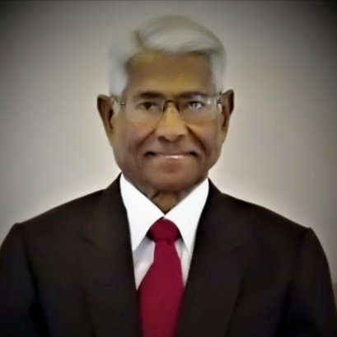
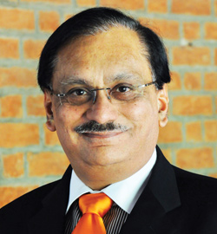
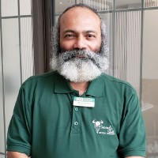
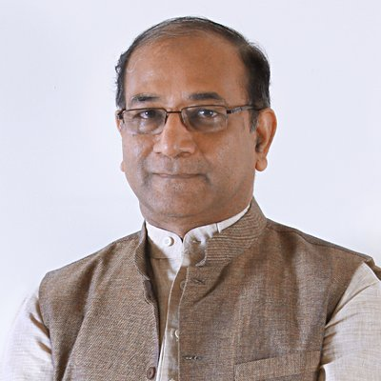
Advisory Board Members
Dr. Bhuvan Unhelkar
Dr. Prabhat Ranjan
Mr. J. C. Shukla
Mr. Pratul Shroff
Professor of Information Technology; Consultant
Sarasota, Florida
Vice Chancellor at D Y Patil International University, Akurdi, Pune
Former – Director, TIFAC
CEO / Managing Director at Nahak Overseas Limited
MBA – IIM, Ahmedabad
Philanthropist, Thinker & Doer!!
Former – Founder of eInfochips
Current – Founder for Dr. K. R. Shroff Foundation

Slide 8
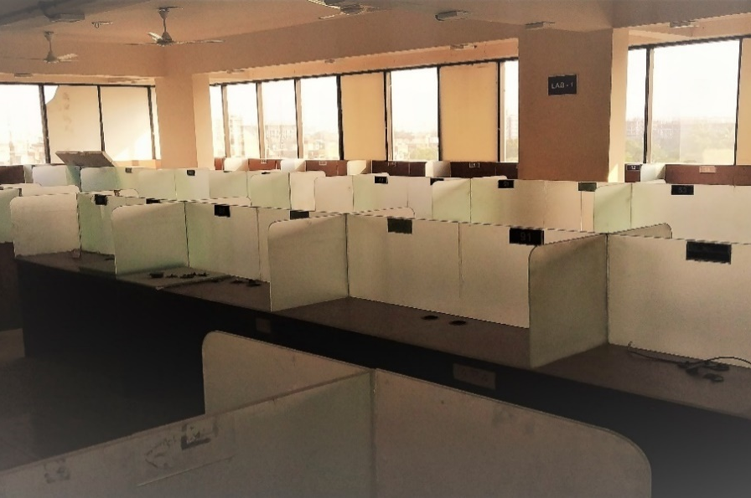
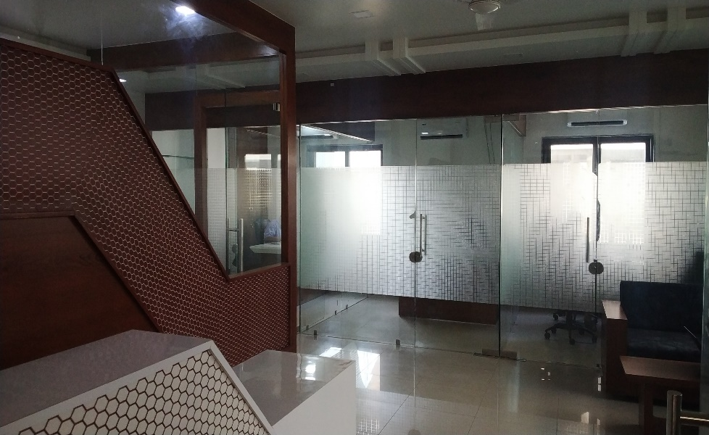
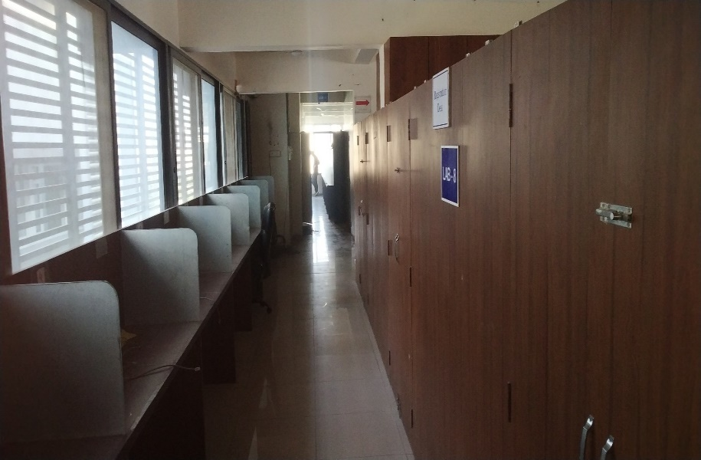
Introduction
About Orena Solutions:
visionary Information and Communication Technology company,
looking to rejuvenate the employability levels of the Indian workforce.
Research Centre to support training as well as building future products
Industry Experts across the globe with offline campuses (blended Learning model)
Headquartered in Vadodara, Gujarat with Research Centre in Noida and Surat.

Slide 9
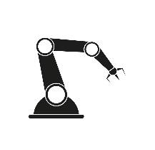
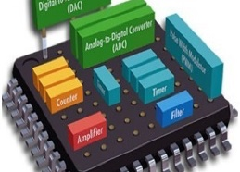





Domains
Automation
Embedded Systems
Digitalization
IT & ITES
Industry 4.0
Consumable Durables
E-Commerce

Slide 10






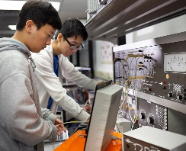
Our Services
Making Industry Ready
Talent Acquisition
Expert Exchange
Corporate Workshop
IP Patent & Development
Setting up
Research Centers
Executing Industrial
Projects

Slide 11
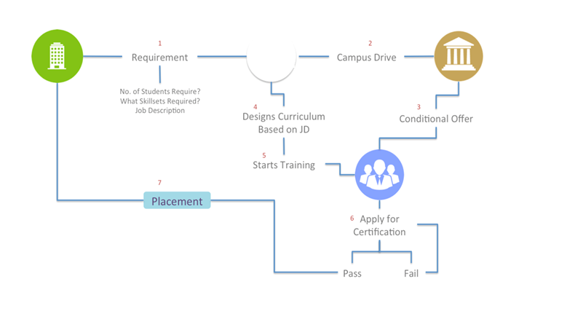
Campus Recruitment and Training

Slide 12
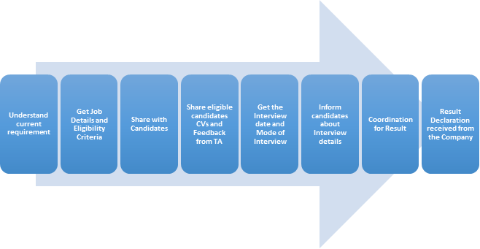
Talent Acquisition
Talent is acquired depending on their skills, ability to work, capability, location, focus and aim.

Slide 13
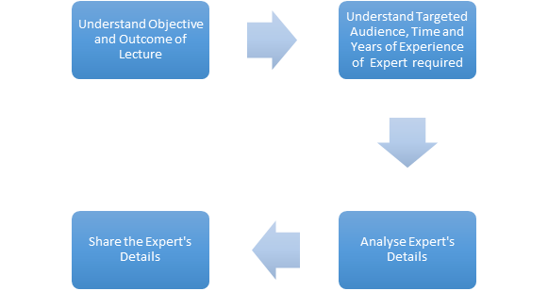
Expert Exchange

Slide 14
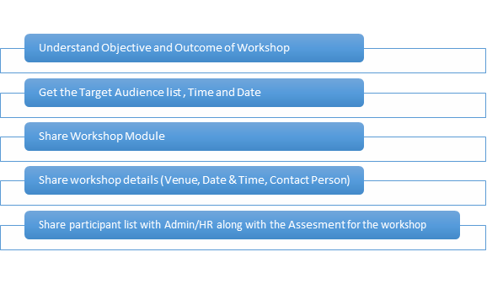
Corporate Workshop
The target audience are the current employees of the company. Based on the requirements of the projects technical skills, behavioral skills as well as project management skills are the part of the workshops.
All the workshops are hands-on training where participants work on a number of training activities rather than passively listen to a lecture or presentation.

Slide 15
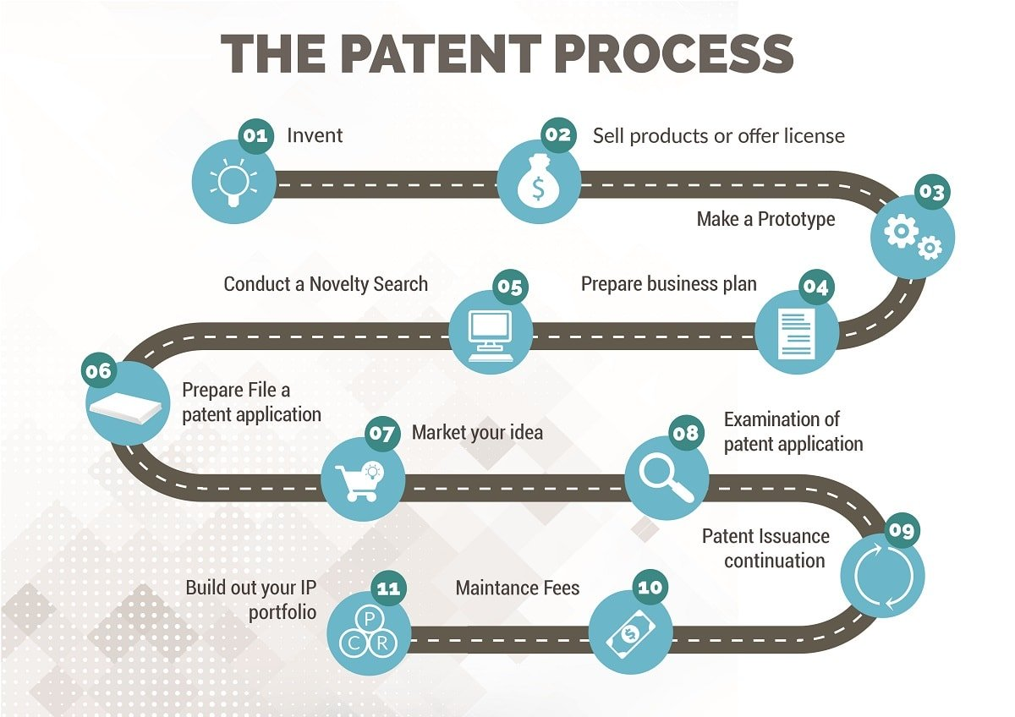
IP Patent and Development
Innovation means doing something new that improves a product, process or service. Many innovations can be protected through intellectual property (IP) rights.

Slide 16



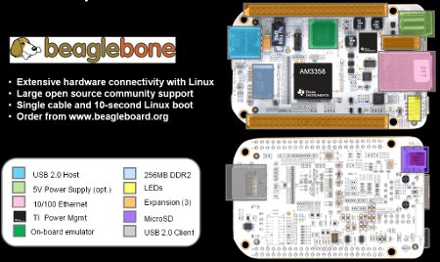
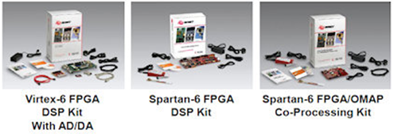


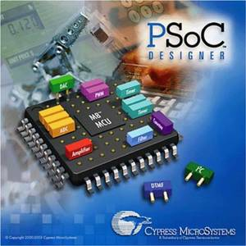


Setting up Research Labs

Slide 17
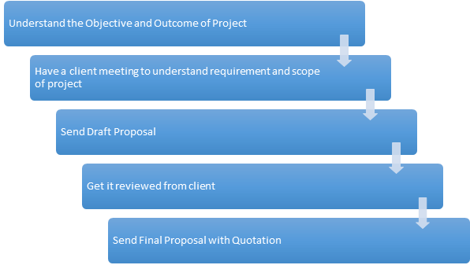
Industry Defined Project

Slide 18



Product development (IT and Embedded)
The creation of products with new or different characteristics that offer new or additional benefits to the customer.
Product development may involve modification of an existing product or its presentation, or formulation of an entirely new product that satisfies a newly defined customer want or market niche.
Chronica
ezGeoCapture
ezNetScan
HRMS
eLearning
ERP

Slide 19
Experts
Digicomm Ltd
Physical Design
Prof. Rahul Dubey
Computer Architecture
Meti Ltd
Embedded Systems (PSoC)
Dr Saurin Mehta.
GIS
Rajesh Nanvandar
Physical Design
Vandana Salve
Device drivers
Dr. Kiran Paramar
DSP
Vijay Chachra
Hardware Board Design
Prashanth Thakkar
Algorithms
Roopa Ramaswamy
DFT
Anand Moghe
Digital VLSI Design
Vijay Kumar Chakka
Digital Signal Processing
VRSSPL
Software and Android
Mihir Shah
Embedded Hardware
Furokh Sheikh
Linux

Slide 20




Industry Recognition

Slide 21



Universities and Knowledge partners
Wingman Partners– Noida

Slide 22
Our Clients
“ Passion leads to design, design leads to performance, performance leads to SUCCESS!”
2020
Relcon Systems
Dhyey Consulting
Fine Line Circuit

Slide 23









Our Clients - Development, Recruitment
Breno labs Pvt. Ltd
Bangalore
Smart Node
Vadodara
Arastu Systems Pvt. Ltd
Ahmedabad
Crescent World
Ahmedabad
Parabia
Transport
Vadodara
Credence Management Corporation
Vadodara
Permaweld
Bangalore, Karnataka
Remax
Brokerage Firm
Jenex Technologies
Vadodara

Slide 24

REVENUE MODEL
To a great warm-up
Planning to any temperature
CAMPUS RECRUITMENT & TRAINING: 40%
TALENT ACQUISITION : 20%
EXPERT EXCHANGE: 0%
COROPORATE WORKSHOP : 10%
IP PATENT & DEVLOPMENT: 30%
CAMPUS RECRUITMENT & TRAINING: 35%
TALENT ACQUISITION : 20%
EXPERT EXCHANGE: 0%
COROPORATE WORKSHOP : 5%
IP PATENT & DEVLOPMENT: 40%

Slide 25
Past Experiences
1
IP Patent
1500 Engineers
Trained
98%
Placement
20
Intellectual Properties
3
Entrepreneurs.

Slide 26
Road Ahead
Research Projects
  Image Compression using DWT
  Solar Tracking Generating Power System
  Optimising ASIC design cycle
  Elderly Assistance device
  Green House Automation
  Home Automation
  LCD Driver Development interfacing with Panda Board
New courses Introduced
Geographic Information System
PCB Design
Automatic Toy Car
Device Driver
IBM mainframe
Blogging and LinkedIn

Slide 27

4th Floor, Urban Complex, Near Panch-mukhi Hanuman, Vasna-Bhayali Road, Baroda – 390012
Reach us at-
project@orena.solutions
www.orena.solutions
+91 98243 47721

Slide 28



Follow Us
LinkedIn
Instagram
Facebook
Orena Solutions Pvt. Ltd. (Admin Page)
Orena Foreign Collaboration
Orena Solutions Pvt. Ltd.
Orena Solutions (Business Page)
Orena Product Selling
Orena Foreign Collaboration
Orena Solutions Pvt. Ltd. Development
Orena Solutions Pvt. Ltd
Orena Solutions Product Selling
Orena Development
Orena Solutions Development
Orena Foreign Collaboration
LinkedIn Product Selling

Slide 29
THANK YOU.

